Slide 1


SPORTING GOODS SALES INSIGHTS

Slide 2

Content :
About Data
Data Source (Data Collection)
Data Transformation.
Sales Overview.
Sales Insights.
Sales Performance.
Sales Trend lines/ forecasting.

Slide 3

1. About Data : This dataset comprises Sporting Goods Company Sales Analysis Data from 2011 to 2016, encompassing 6 countries and 53 states across 3 product categories, 17 subcategories, and 130 products, along with gender and age group categories. Using this information, we calculated several KPIs, such as Total Revenue, Total Profit, and Total Cost, and presented various visualizations based on these KPIs.
2. Data Source : I obtained the dataset from Kaggle , which is a freely available source, and I have mentioned the link below.
Sales Data (kaggle.com)

Slide 4

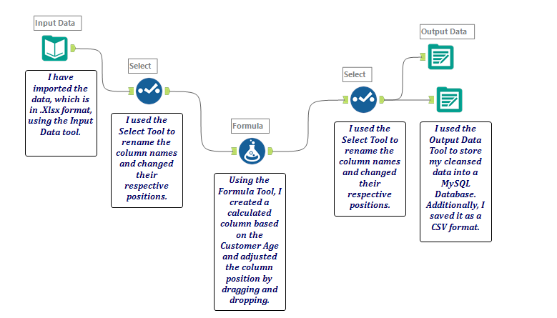
Data Transformation : With the help of the alteryx Data Analytics Tool, we cleansed, transformed, and modified the data, storing it in both a MySQL database and a CSV format.

Slide 5

DASHBOARD VISUALIZATION

Slide 6
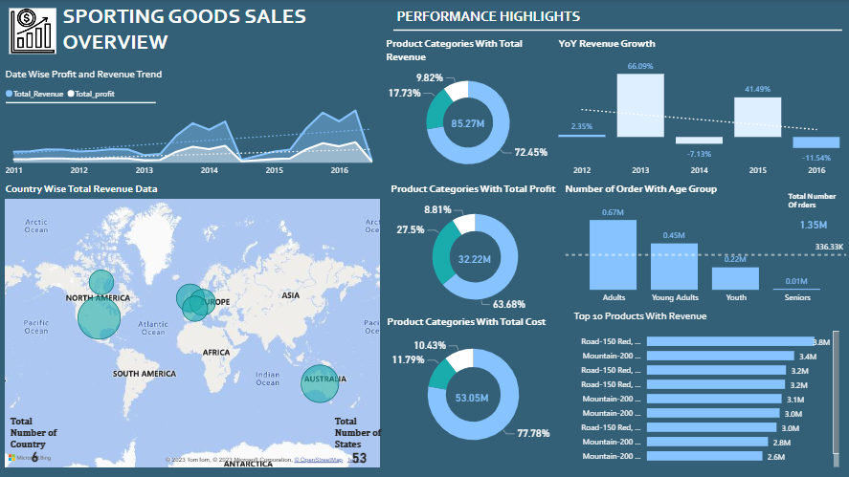
SALES OVERVIEW :

Slide 7
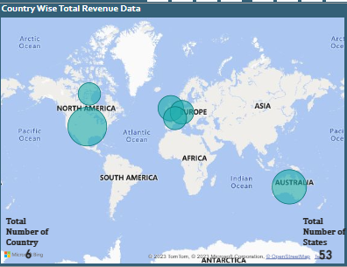
SALES OVERVIEW :
Utilizing the area chart, we calculated the date-wise total revenue and total profit. The trend lines for both revenue and profit were portrayed separately. Notably, in 2014 and 2016, both revenue and profits were higher compared to the other three years. In 2014, Quarter 2 showed a peak with Total Revenue at 7578197 and Total Profit at 3101769. Meanwhile, in 2016, Quarter 2 exhibited a Total Revenue of 9607507 and a Total Profit of 3773110.
Using a map chart, we displayed the country-wise revenue generation. United States, Australia, and the United Kingdom emerged as the top three countries with the highest revenue generation. In numerical terms, the United States generated 27975547, Australia generated 21302059, and the United Kingdom generated a total revenue of 10646196.

Slide 8
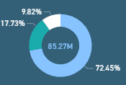
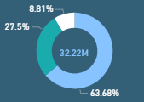
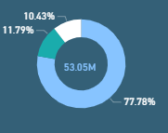
The Total Revenue amounts to 85.27%. The Year-over-Year (YoY) revenue growth in 2013 recorded the highest growth percentage at 66.09%, whereas 2016 depicted a negative growth rate of -11.54%. Within the product category, Bikes had the highest revenue generation, amounting to 61782134, contributing 72.45% to the total. Among the products, Road-150 Red, 62 generated the highest revenue, totaling 3829416.
clothing
clothing
clothing
Bikes
Accessories
Bikes
Bikes
Accessories
Total Revenue
Total Profit
Total Cost
In terms of order quantities, adults lead the trend with 672417 orders, followed closely by young adults with 446875 orders. Both age groups have surpassed the average line of order quantity, indicating their significant contribution to the total number of orders

Slide 9
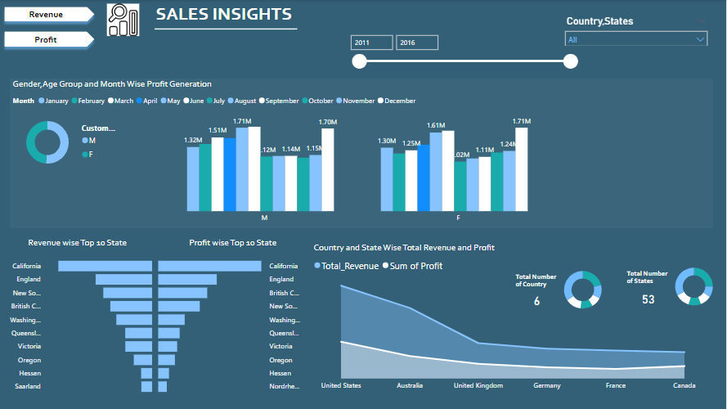
SALES INSIGHTS :

Slide 10
SALES INSIGHTS :
1. Gender-wise Revenue Generated:
Male: 43335409 (50.82%)
Female: 41935599 (49.18%)
2. Gender-wise Profit Generated:
Male: 16487232 (51.17%)
Female: 15733868 (48.83%)
3. United States Generates More Revenues:
Total revenue: 27975547
Total profit: 11073644
4. Senior Age Group Generates Less Revenue and Profit Compared to Other Age Groups in Both Male and Female Categories.

Slide 11
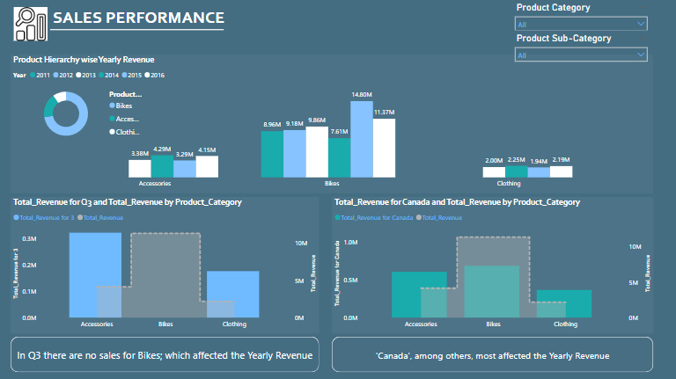
SALES PERFORMANCE :

Slide 12
SALES PERFORMANCE :
Revenue Generated by Categories:
Bikes generate revenue: 61782134 (72.45%)
Accessories generate revenue: 15117992 (17.73%)
Clothing generates revenue: 8370882 (9.82%)
Among these three, Clothing is the product category generating the least revenue.
2. No Bike Sales in Quarter 3 Affected Yearly Revenue Generation.
Among the Six Countries, "Canada" Affected Yearly Revenue Generation.

Slide 13
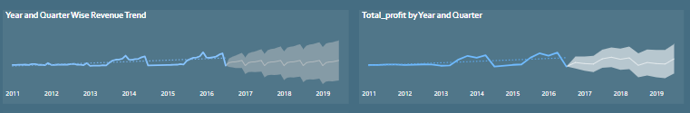
﻿FORECASTING: Total Revenue trended down, resulting in a 25.95% decrease between January 2011 and July 2016.﻿﻿ ﻿﻿Total Revenue started trending up on April 2015, rising by 191.39% (1405973) in 4 months.﻿﻿ ﻿﻿Total Revenue jumped from 734608 to 2140581 during its steepest incline between April 2015 and August 2015.﻿﻿ ﻿Total Revenue trended up, resulting in a 258.72% increase between July 2016 and June 2019.
﻿Total profit trended down, resulting in a 60.61% decrease between January 2011 and July 2016.﻿﻿ ﻿﻿Total profit started trending up on April 2015, rising by 375.35% (2979364) in 4 quarters.﻿
﻿Total profit jumped from 793746 to 3773110 during its steepest incline between April 2015 and April 2016.﻿﻿ ﻿
Total Profit trended up, resulting in a 767.76% increase between July 2016 and June 2019.

Slide 14
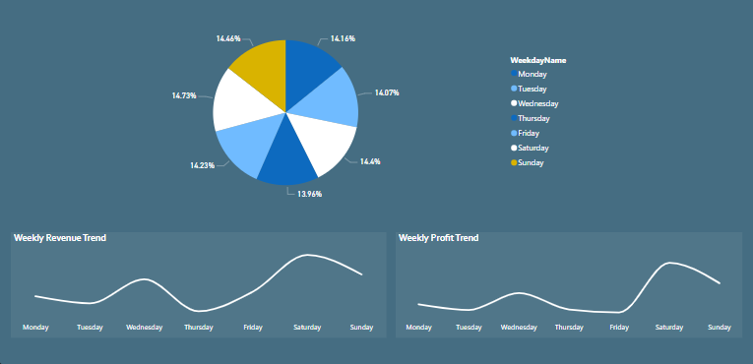
Saturday Accounted for 14.73% of Total revenue where is Sunday accounted for 14.46% total revenue.

Slide 15
THANK YOU

